Slide 1
BLE (Bluetooth Low Energy)
BLE standard presentation

Slide 2
Introduction

Slide 3
Table of content
Introduction to BLE
BLE operation
Basic concept of BLE
BLE core system architecture
  Host Layer
  Link Layer
  Physical layer

Slide 4
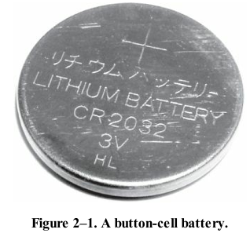
introduction
Bluetooth low energy is designed as a complementary technology to classic Bluetooth, but it takes a completely different direction. Instead of increasing the data rates available, it has been optimized for ultra-low power consumption and been extremely low cost
Why Bluetooth Low Energy (BLE) Is Low-Cost
  Free ISM Band: BLE operates in the 2.4 GHz ISM band, which is open and license-free worldwide. avoiding paid radio spectrum keeps costs low.
  Low Licensing Fees: Developers pay a membership
  Low Power Design BLE runs on small, inexpensive batteries like button cells, reducing material, and replacement costs. This trade-off limits data rate

Slide 5
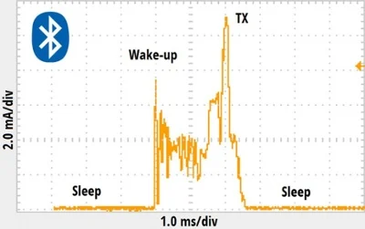
Basic concept of BLE
Time Is Energy
  BLE reduces energy use by minimizing how long devices stay
  active for device to be discoverable it must transmit a very
  short message three times on three different frequency
  every few seconds, short transmit/receive windows
Asymmetric Design
  BLE divides tasks unevenly: low-power devices (advertisers, slaves) do the simplest jobs, while high-power devices (scanners, masters) handle complex ones. This ensures the smallest, battery-powered devices stay efficient and cheap

Slide 6
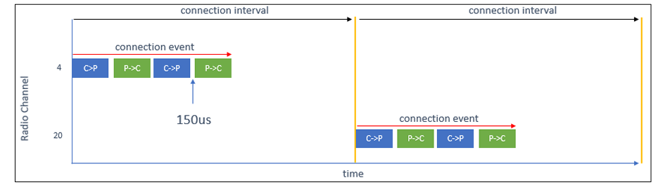
BLE operation
BLE operate on 40 channel each channel has 2MHz BW
BLE can be connection oriented or connectionless determined by GAP in host layer
Connection between peripheral and central are through connection interval different parameters are specified make BLE save power such as connection interval time , peripheral latency, channel hop sequence
Advertisement packet send on 37,38,39

Slide 7
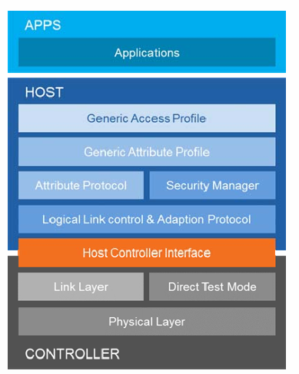
BLE core system architecture: Host layer
Host Layer Overview:
  Use client server architecture
  defines how data is exposed as attributes between a client and a server, and how devices share information like battery level or heart rate
  send commands to control layer to control radio operation

Slide 8
BLE core system architecture: link layer states
link Layer Overview:
  Defines several distinct ways of using the underlying radio for connectionless, connection-oriented
  the Standby state : doesn’t send or receive any packet
  Advertising state: transmitting advertising physical channel packets
  Scanning state: will be listening for advertising physical channel packets.
  Initiating state : will be listening for advertising physical channel packets from a specific device(s) and responding to these packets to initiate a connection
  Connection state : state can be entered either from the Initiating state or the Advertising state

Slide 9
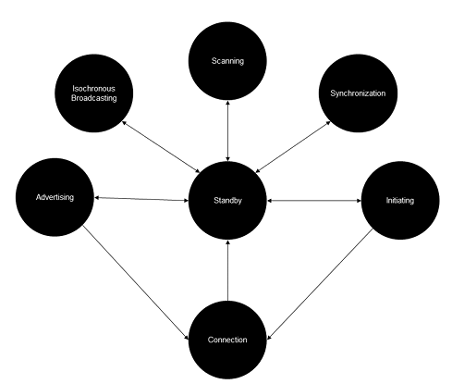
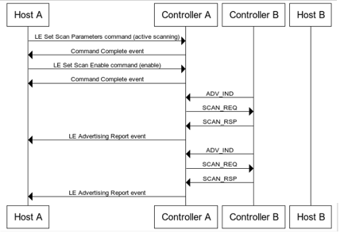
BLE core system architecture: Host Link layer interface

Slide 10

BLE core system architecture: Link layer air packet
Link Layer defines air interface packet formats, bit stream processing procedures such as error checking, a state machine and protocols for over-the-air communication and link control.

Slide 11
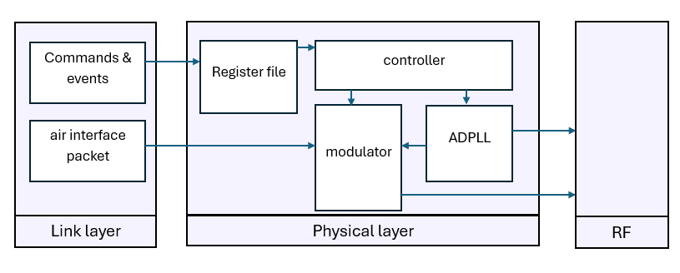
Physical layer interface with link layer

Slide 12
GFSK

Slide 13
Table of Content
Modulation
  What/Why modulation
  Modulation Rate
GFSK
  Traditional FSK
  GFSK Modulation
  GFSK Advantages/Trade-offs
  GFSK Modulation Index

Slide 14
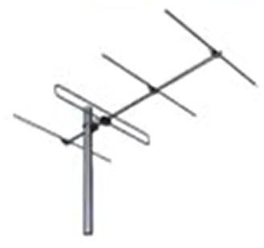

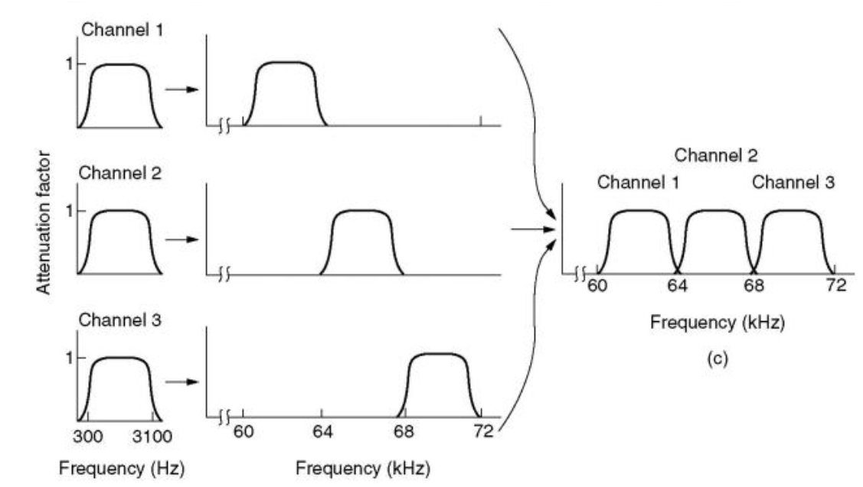
Why Modulation
Modulation is the Variation/change of a high-frequency carrier signal property (such as its amplitude, frequency, or phase) in proportion to a lower-frequency information signal (such as digital data or audio).
Why not transmit data directly?
Antenna Length: High-frequency carrier signals allow the use of smaller antennas, as the required antenna size is inversely proportional to the frequency.
To Fit Multiple Users in the Same Medium (Multiplexing):Modulation allows multiple users by frequency division multiplexing.

Slide 15
Modulation Rate and Bit Rate in BLE
  Two modulation schemes are defined:
  The mandatory modulation scheme (“1 Msym/s modulation”) uses a shaped, binary FM to minimize transceiver complexity. The symbol rate is 1 Msym/s.
  The 1 Msym/s modulation supports two PHYs:
  • LE 1M, with uncoded data at 1 Mb/s. (Data rate = Symbol rate)
  •LE Coded PHY transmits symbols at 1 Msym/s. (Data rate < Symbol rate “due to redundancy bits”)
  This helps BLE achieve long-range communication, useful in IoT.
  “coded” refers to the use of forward error correction (FEC) and symbol-level coding at the physical layer. Rather than sending one symbol per bit (as in an uncoded PHY), a coded PHY sends multiple symbols per bit. This redundancy allows the receiver to better detect and correct errors caused by channel impairments (noise, fading, interference).

Slide 16
Modulation Rate and Bit Rate in BLE
  An optional modulation scheme (“2 Msym/s modulation”) is similar but uses a symbol rate of 2 Msym/s.
  The 2 Msym/s modulation supports a single PHY:
  • LE 2M, with uncoded data at 2 Mb/s.
  Higher symbol rate → faster data transmission (faster communication).
  But Shorter range than LE Coded, because it is less robust to noise.
  A device shall support the LE 1M PHY. Support for the LE Coded PHY is optional.

Slide 17
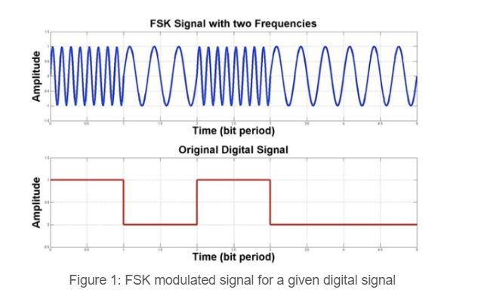
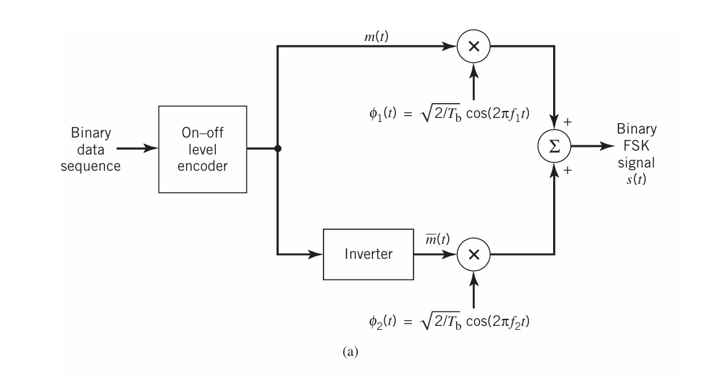
Traditional FSK Modulation
  In FSK, independent oscillators generate separate in-phase and quadrature components.
  These oscillators switch at the start of each symbol period to create the carrier frequency for modulation.
  However, due to varying amplitudes and phases of the oscillators, abrupt frequency changes occur for every bit transition.
  The modulated FSK signal has a wide spectrum (out of band energy) with non-negligible side-lobes.

Slide 18
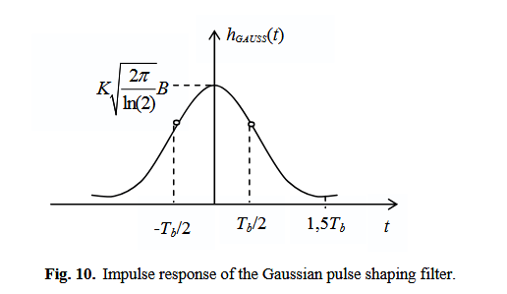
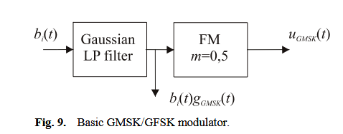
GFSK Modulation
GFSK uses a Gaussian filter (LPF) before modulating the baseband waveform signal (the data signal).
The Gaussian filter smooths out the abrupt frequency changes in FSK(called pulse shaping).
The filter’s impulse response follows a Gaussian function, which narrows the frequency response.
As a result, any sudden frequency shifts are filtered out, making transitions smoother.
The spectral width of the GFSK signal is reduced compared to unfiltered FSK.

Slide 19
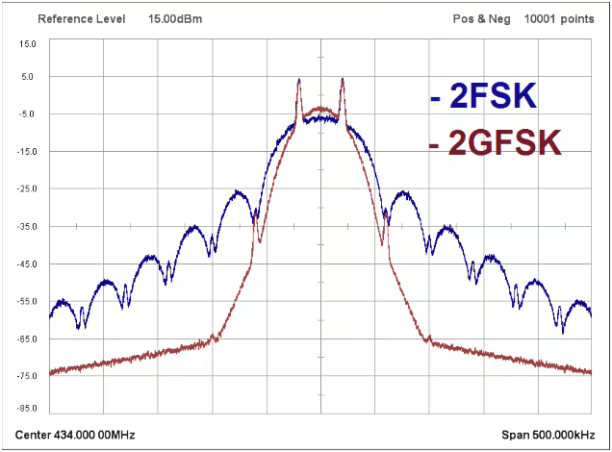
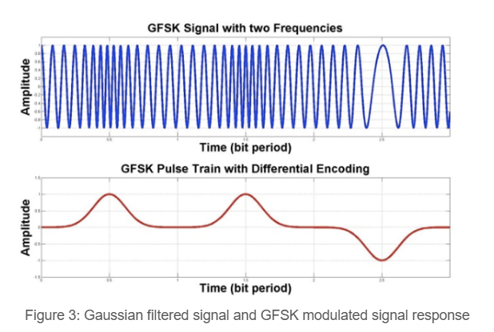
GFSK Advantages/Trade-offs
  Reduced side lobes: GFSK minimizes sideband power and out-of-band spectrum.
  Better spectral efficiency: By shaping the pulses, GFSK achieves improved spectral utilization.
  Constant Envelope: GFSK/FSK modulates only the frequency and not the amplitude, the transmitted signal has a constant envelope. This allows the use of nonlinear power amplifiers (such as Class C or E), which are more energy-efficient — an essential feature for battery-powered devices.
  But…
  While GFSK reduces spectral width, it increases the likelihood of intersymbol interference (ISI) due to spreading in the time domain.

Slide 20

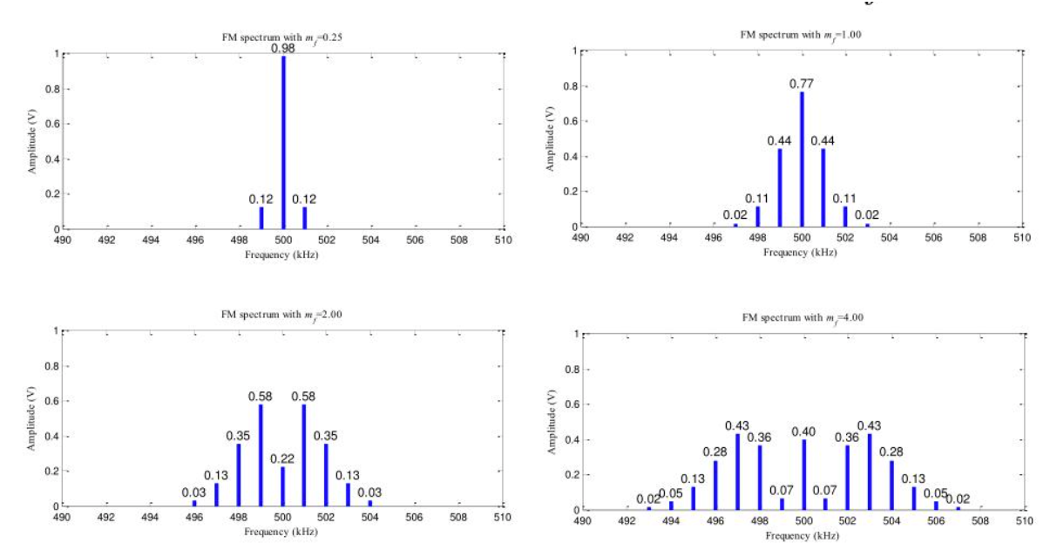
GFSK Modulation index
Modulation index describes how close should 2 symbols (tones) be without creating ISI.
mathematically defined as:
BLE Specification
For the standard BLE 1M PHY, the specification requires a tight range for h:
0.45≤h≤0.55
Too low modulation indices (<0.3) → narrowest possible bandwidth (best spectral efficiency) but poor demodulation performance (receiver struggles to distinguish the tones).
Too high modulation indices (>1) → better noise immunity but wider spectrum, more adjacent channel leakage (decreases spectral effiency of gaussian filter).
0.5 → sweet spot for BLE: achieves the best possible balance maximum spectral efficiency without compromising the required noise immunity.

Slide 21
MSK and GMSK

Slide 22
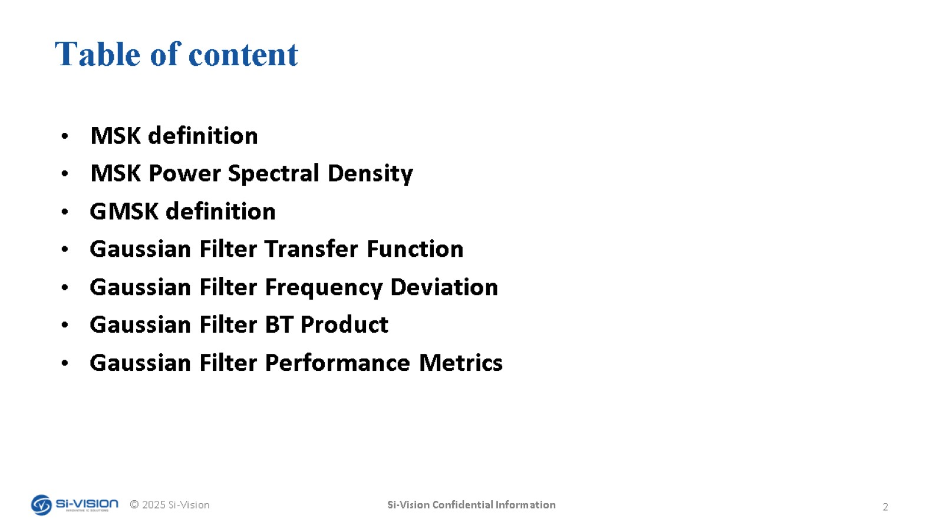
Table of content

Slide 23
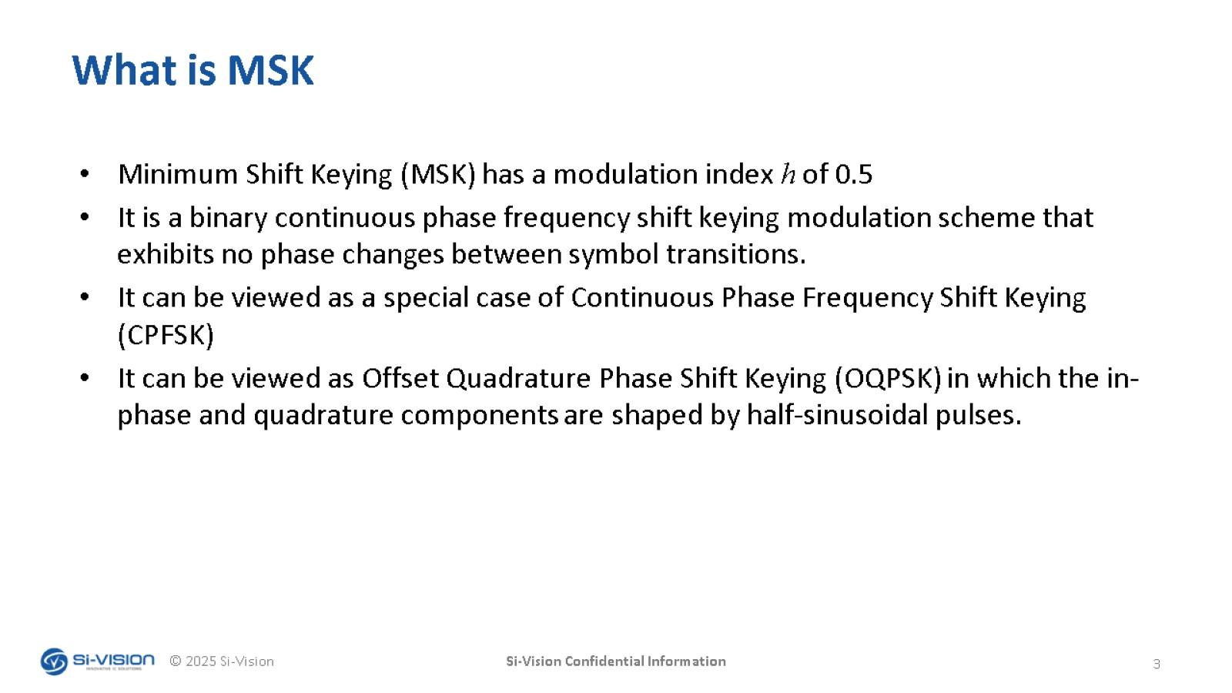
What is MSK

Slide 24
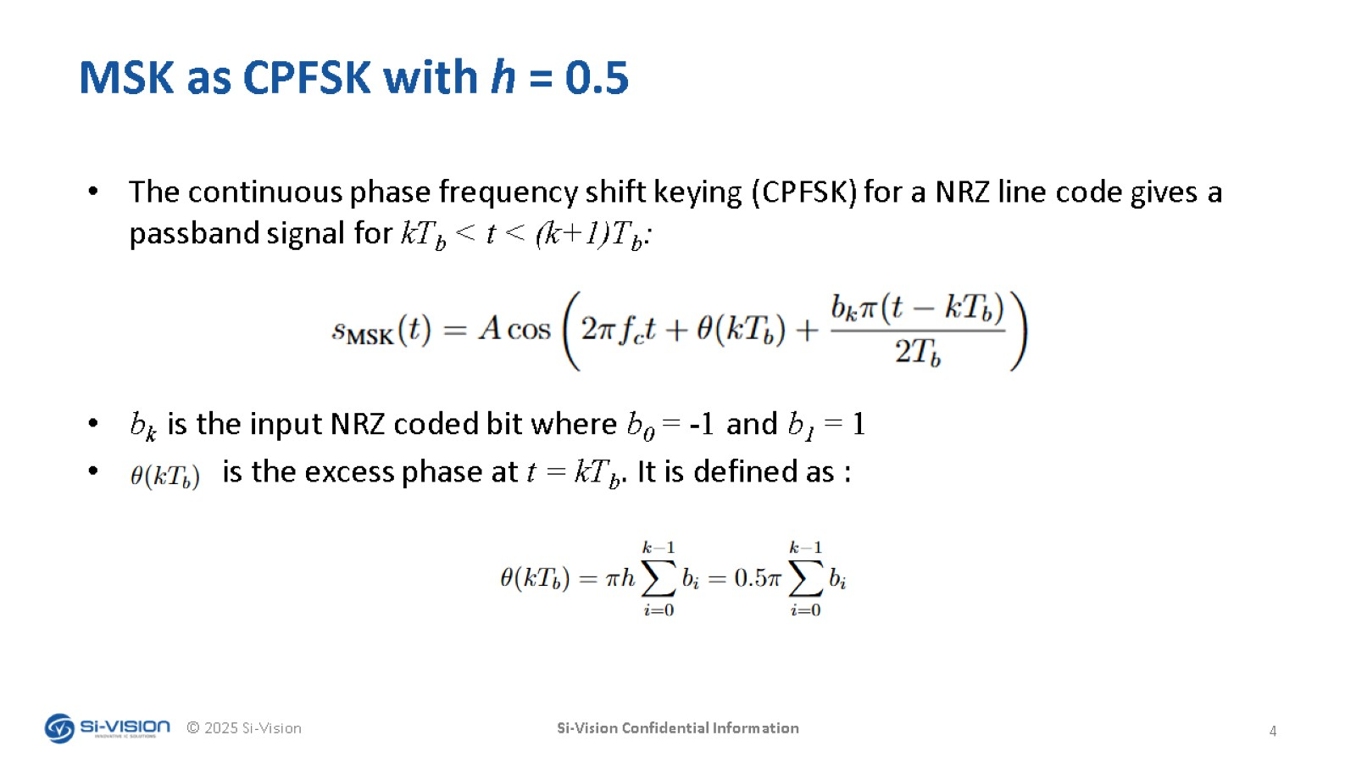
MSK as CPFSK with h = 0.5

Slide 25
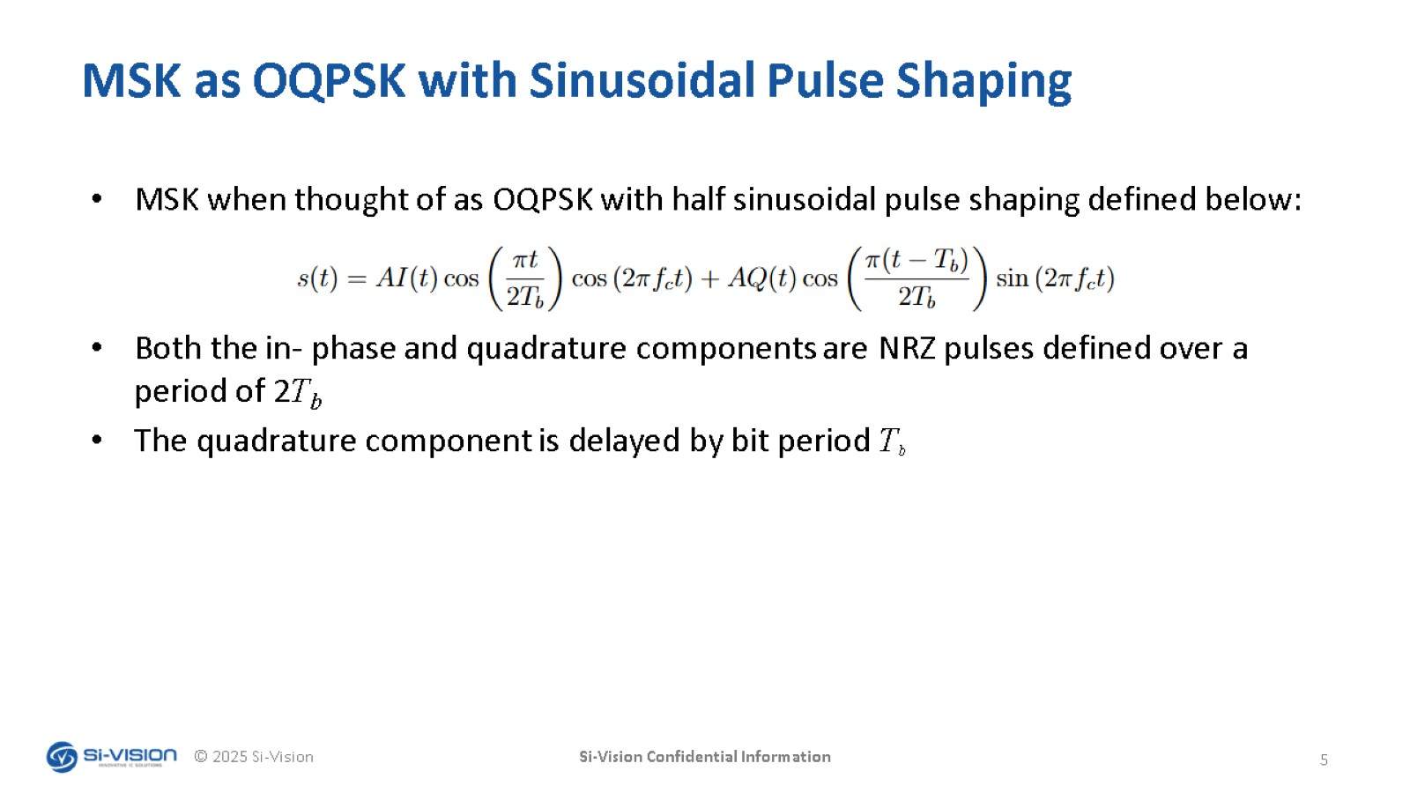
MSK as OQPSK with Sinusoidal Pulse Shaping

Slide 26
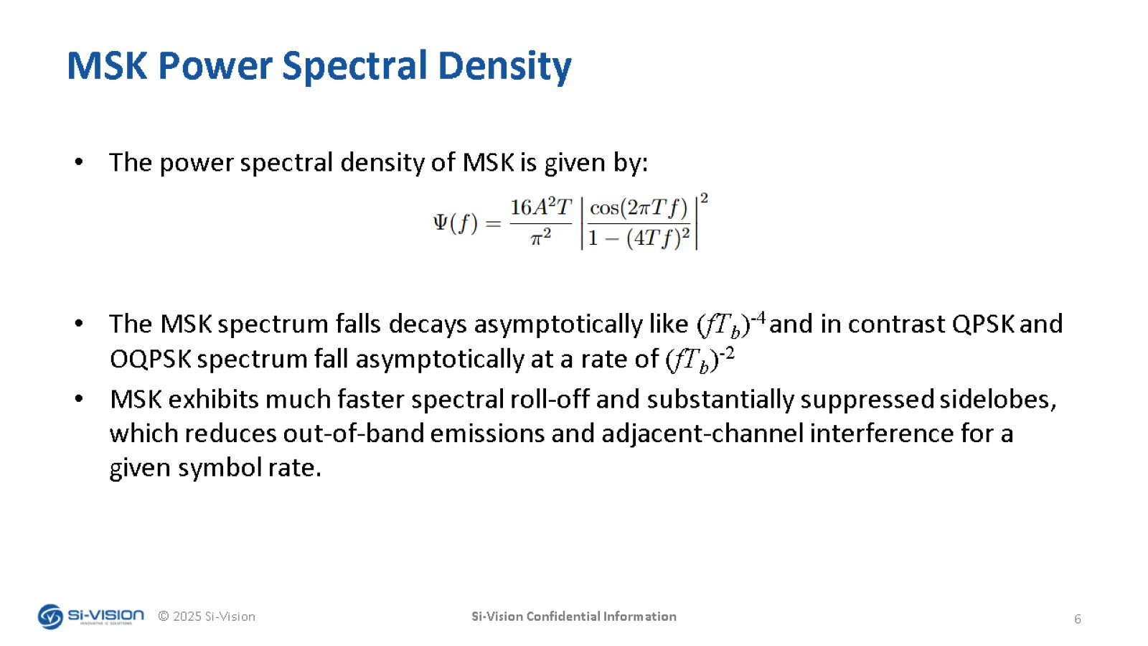
MSK Power Spectral Density

Slide 27
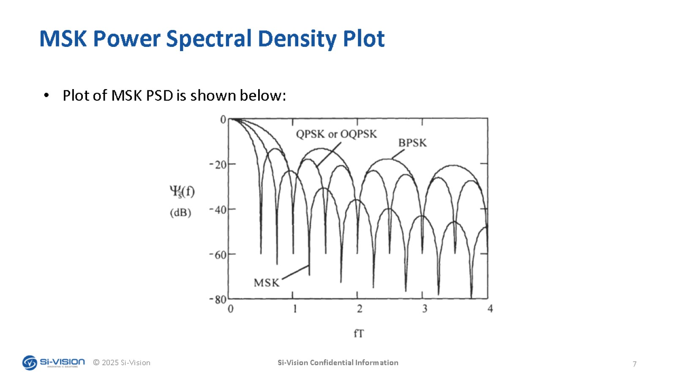
MSK Power Spectral Density Plot

Slide 28
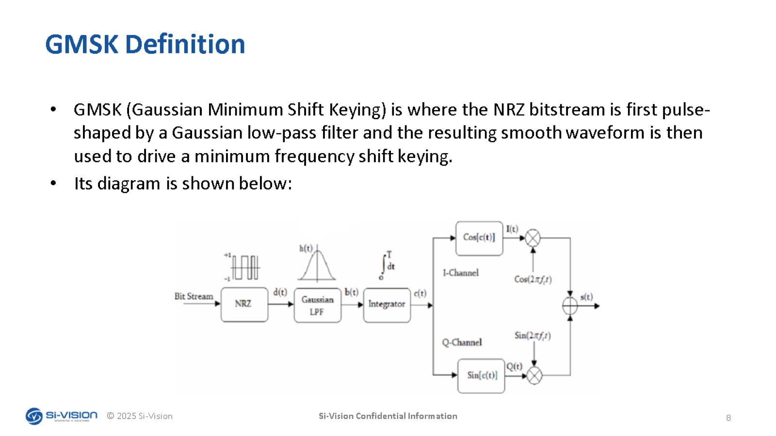
GMSK Definition

Slide 29
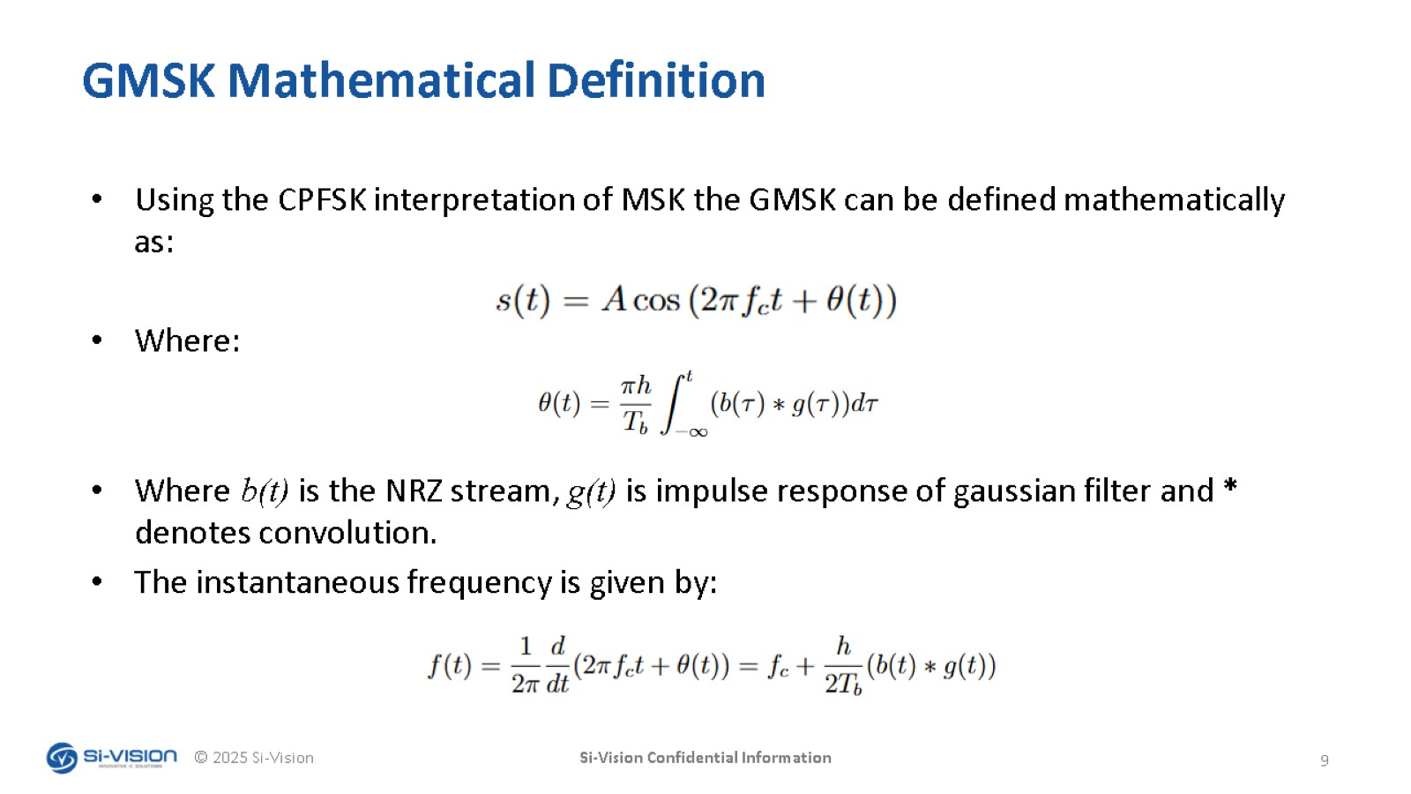
GMSK Mathematical Definition

Slide 30
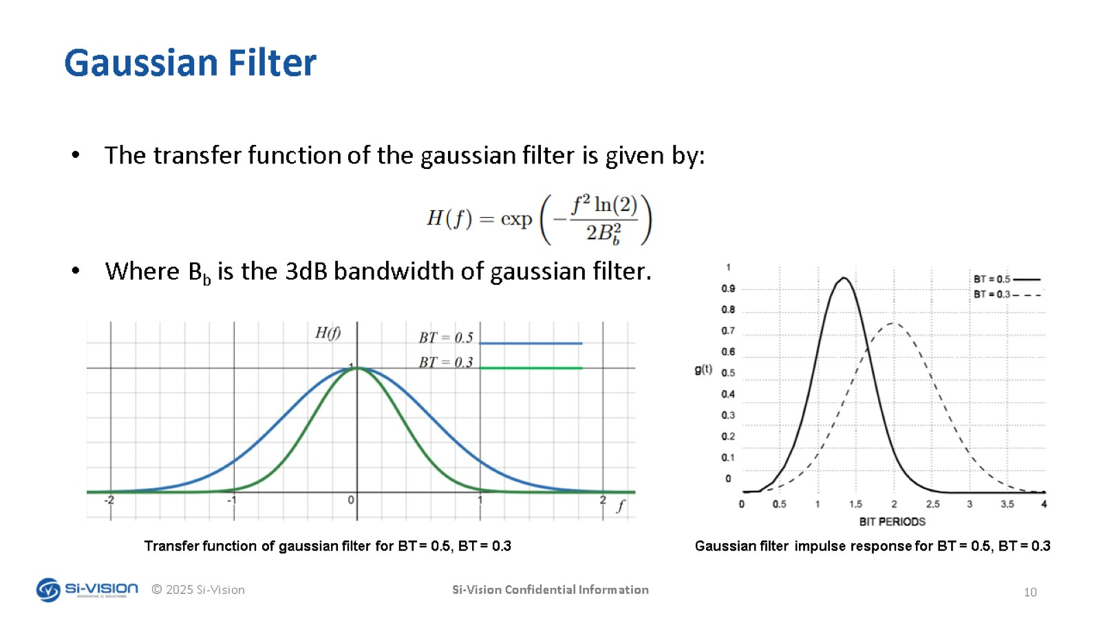
Gaussian Filter

Slide 31
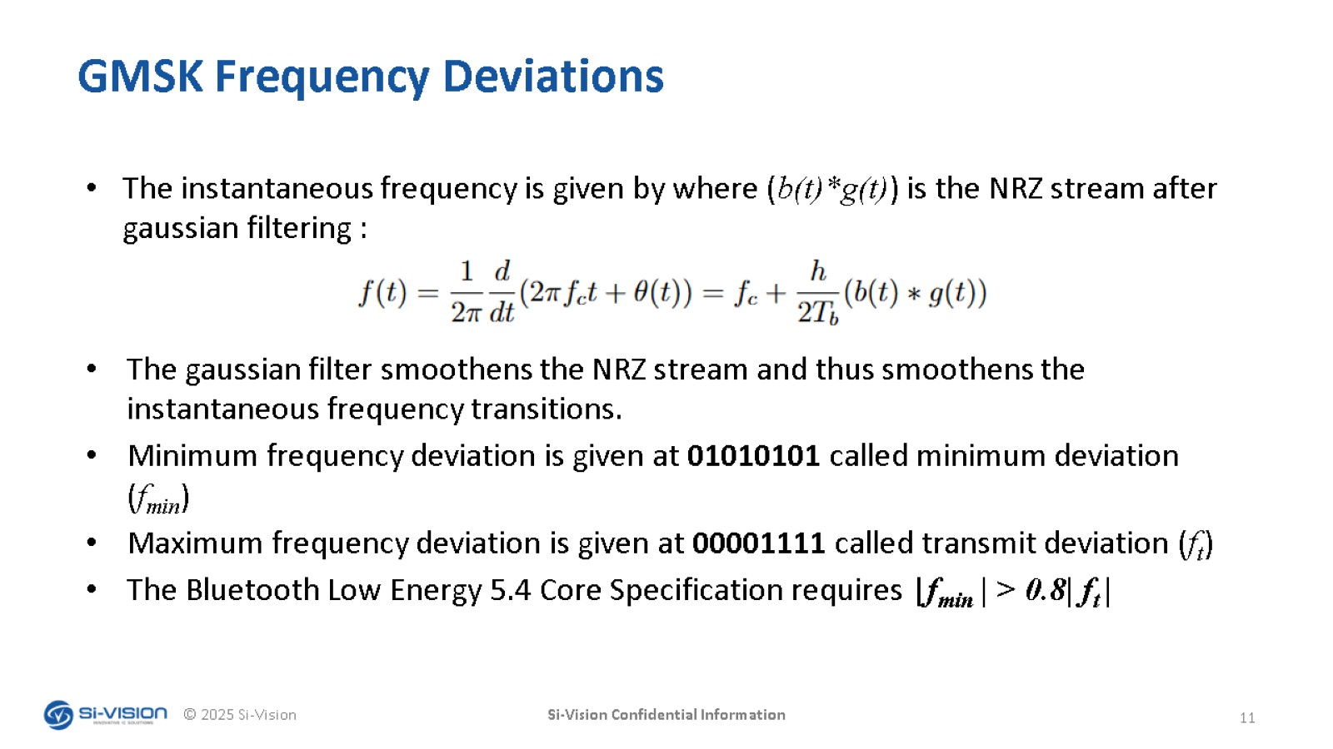
GMSK Frequency Deviations

Slide 32
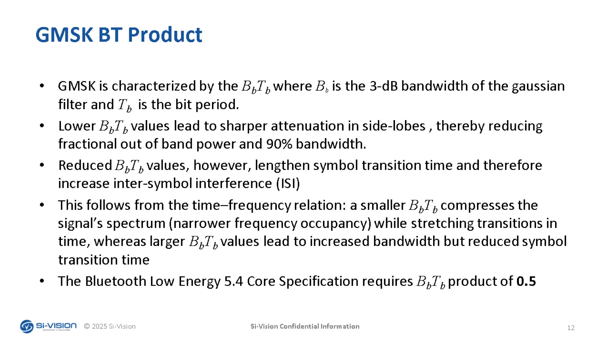
GMSK BT Product

Slide 33
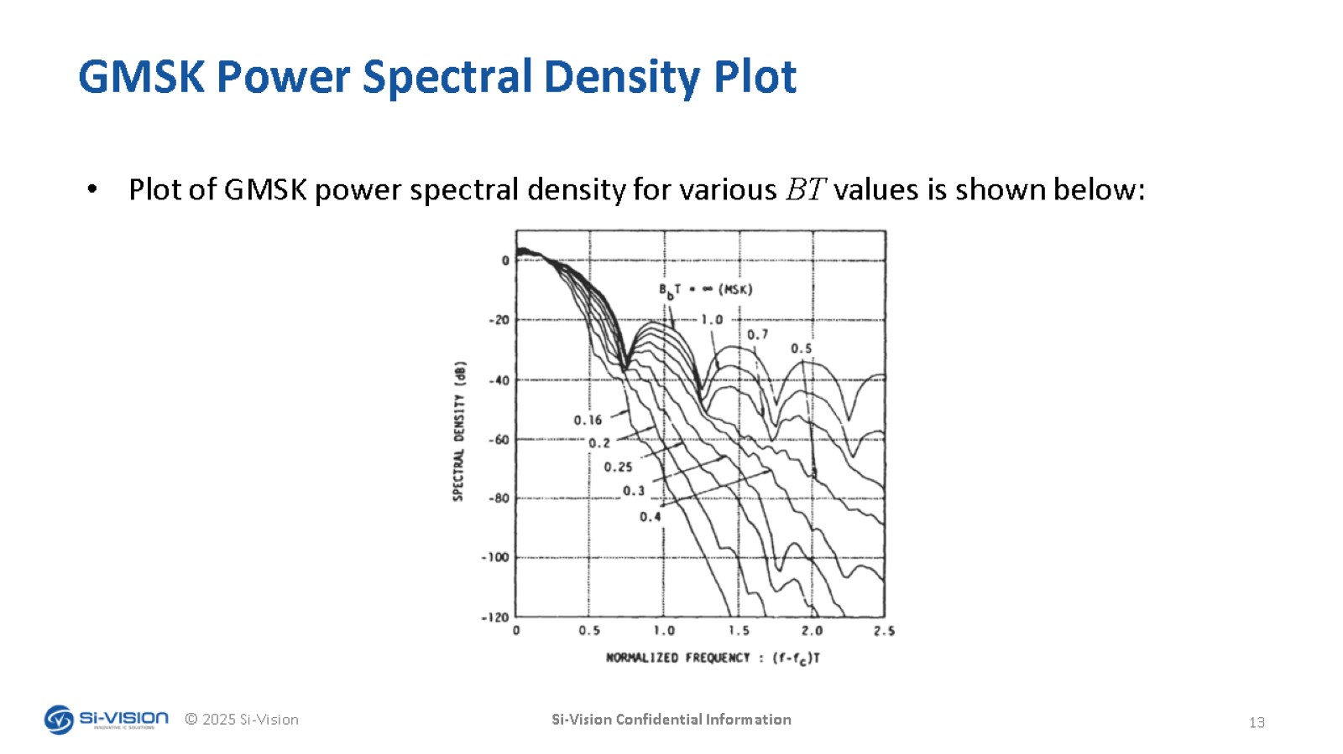
GMSK Power Spectral Density Plot

Slide 34
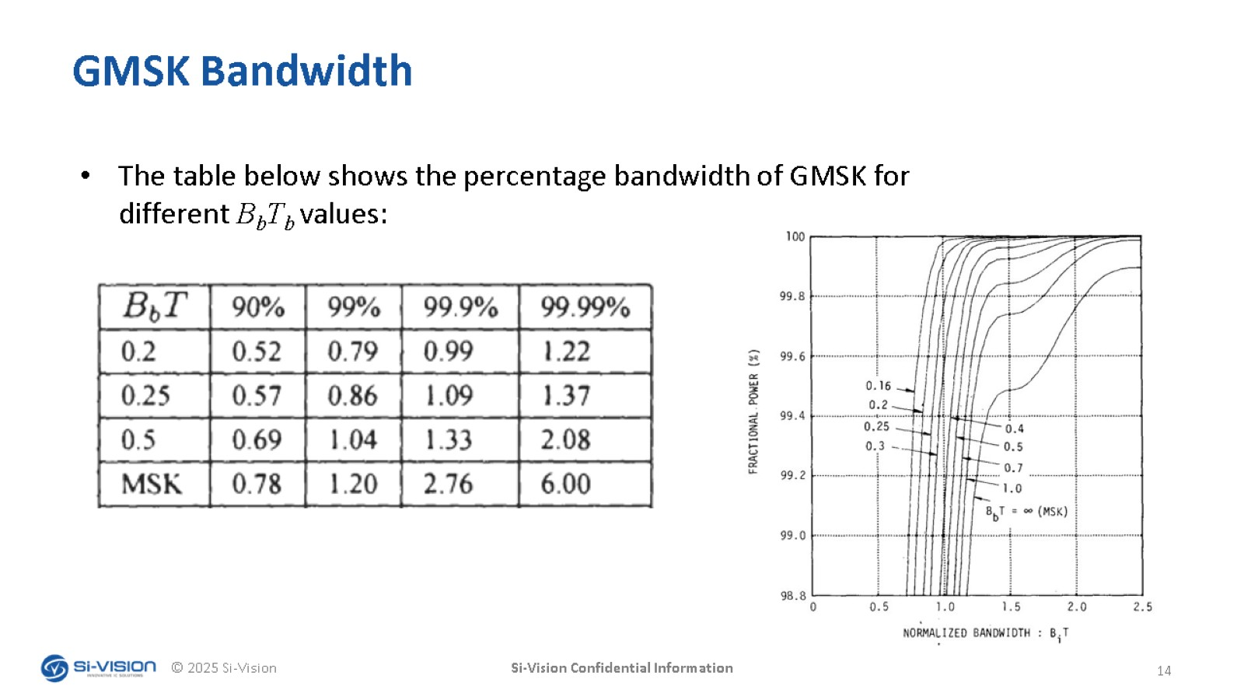
GMSK Bandwidth

Slide 35
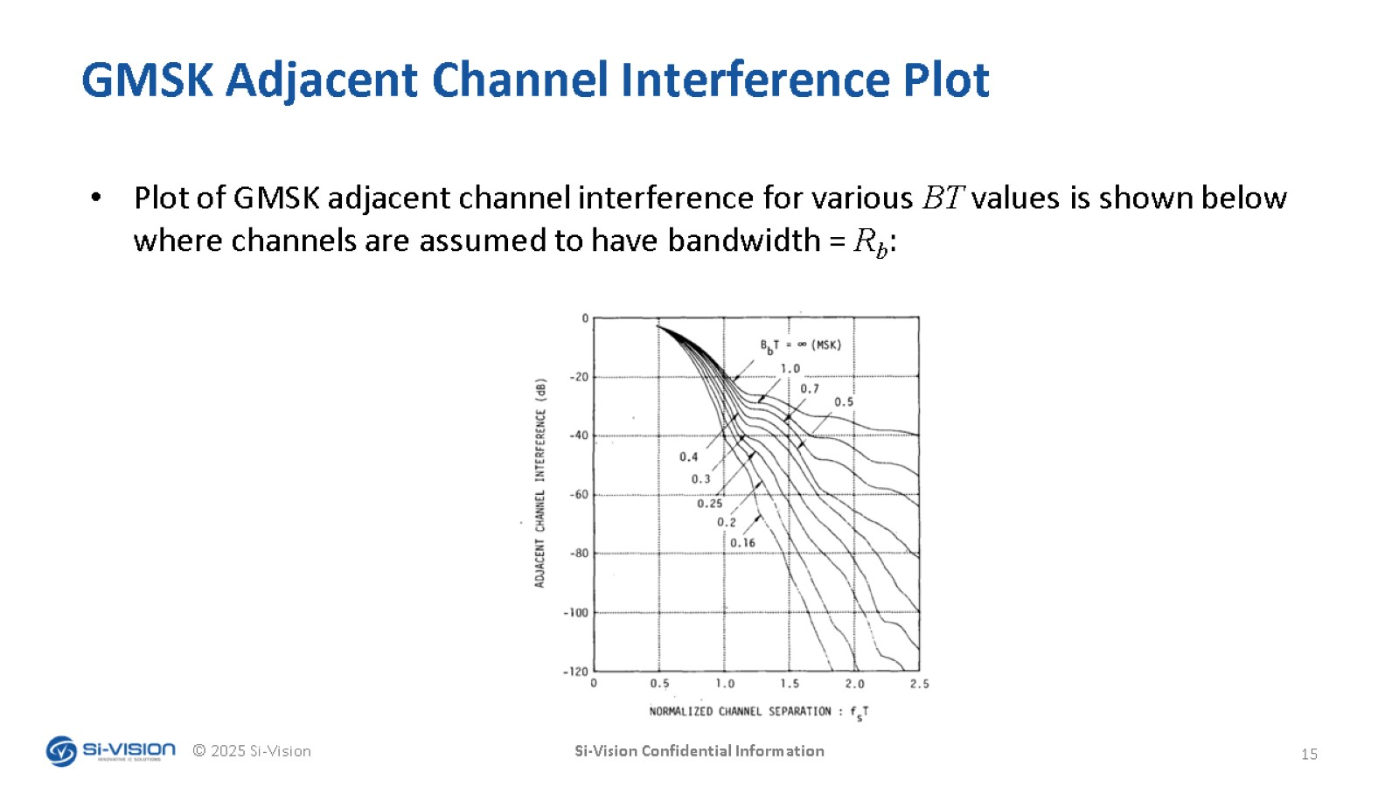
GMSK Adjacent Channel Interference Plot

Slide 36
Eye diagram

Slide 37
Table of content
Eye diagram
  What is an Eye diagram
  Eye diagram of GMSK
  Zero crossing error
  Jitter affects the zero crossing error
  Timing accuracy Frequency deviation

Slide 38
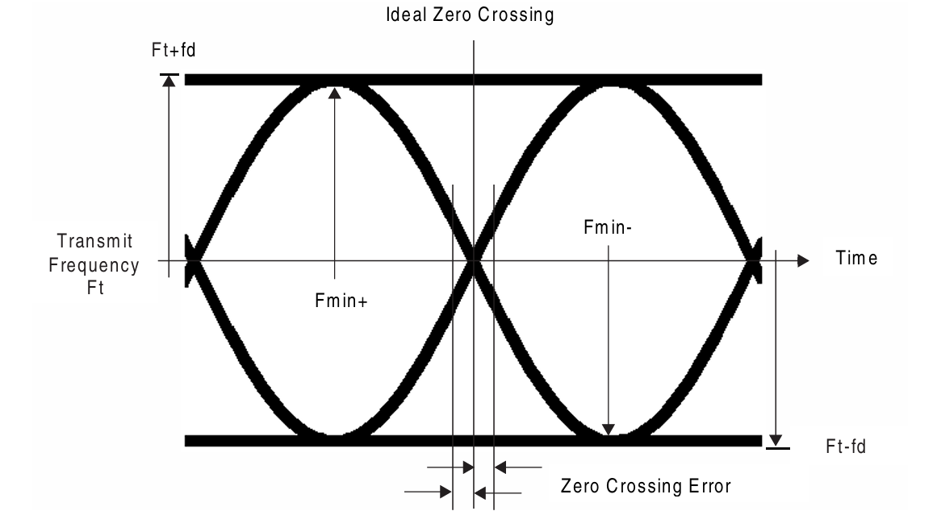
What is an Eye diagram
An eye diagram is a visual way to check the quality of a digital signal.It is made by overlapping many bits of the received signalon an oscilloscope, creating a shape that looks like an eye.The diagram shows how the signal changes between logical 1s and 0s, and helps identify problems such as inter-symbol interference (ISI) that can distort the signal,

Slide 39
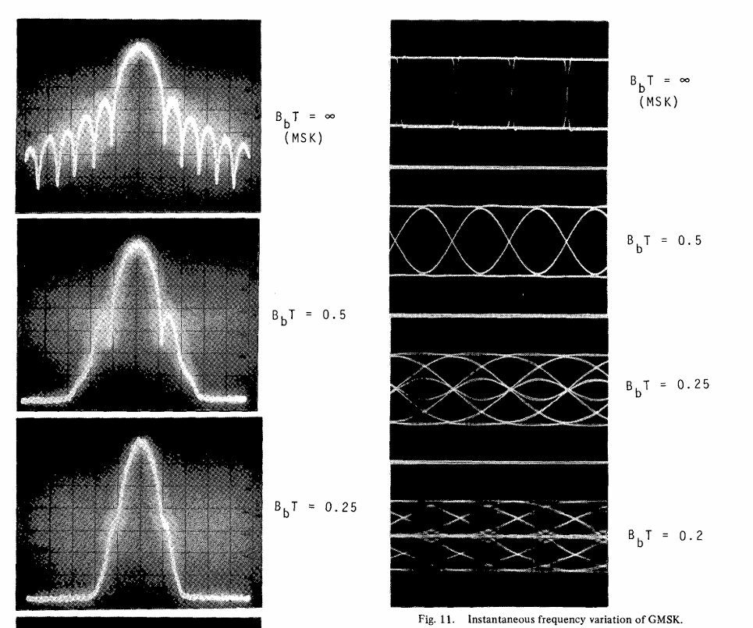
Eye diagrams of GMSK
As BT decreases, the Gaussian filter becomes narrower and smooths the transitions between symbols.
Power Spectral Density:
  Main lobe becomes narrower.
  Side lobes decrease, reducing out-of-band emissions and improving spectral efficiency.
Eye Diagram
  Eye opening becomes smaller and less clear as BT decreases.
  increased Inter-Symbol Interference (ISI) due to smoother frequency transitions.

Slide 40
Zero Crossing Error
What is zero crossing in GFSK?
  In GFSK, the transmitted signal’s instantaneous frequency shifts up and down around a center frequency Ft​, depending on whether you’re sending a “1” or a “0”.
Ideally each zero crossing happens exactly halfway between symbols (at the expected time).
What is the zero crossing error?
  Zero crossing error is the time difference between the expected zero crossing (ideal) and the measured one (actual).
  Zero Crossing Error = t_actual​ − t_ideal​
SPEC.: Zero crossing shall be less than ±1/8 of a symbol period(0.125 micro sec)

Slide 41
Zero Crossing Error
Why zero crossing error is an issue ?
  The receiver may sample the signal at the wrong instant and decode the wrong bit (1 instead of 0).
  Over many bits, small zero-crossing shifts accumulate, making it harder for the receiver to stay synchronized with the transmitter.
Causes of Zero crossing error:
    Oscillator phase noise or jitter: Small timing fluctuations in the RF oscillator cause random shifts in zero-crossing timing.
  Incorrect frequency deviation: When the frequency shift (±185 kHz or ±370 kHz) isn’t accurate, the zero crossings occur earlier or later than expected.
  Gaussian filter distortion: Imperfect filtering or pulse shaping makes the transitions asymmetric, shifting the crossing points.
  Symbol timing inaccuracy: If the transmitter clock drifts beyond the ±50 ppm limit, zero-crossing timing also drifts.

Slide 42
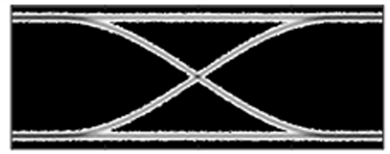


Jitter affects the zero crossing
Jitter is a time uncertainty in signal transitions between logic ‘0’ and ‘1’ and classified one of the main reasons of zero crossing error.
Jitter is classified into:
  Deterministic jitter(DJ): predictable and repeatable. (The most
  common causes of DJ are modulation of the clock due to supply noise,
  cross-talk from other signals or channels, duty cycle distortion).
  Random jitter: unpredictable and noise-induced.
Figure 1 shows an eye diagram with low jitter
Figure 2 shows an eye diagram with high Random jitter
Figure 3 shows an eye diagram with deterministic jitter

Slide 43
Timing accuracy and Frequency deviation
What does timing accuracy means?
  timing accuracy refers to how precisely the transmitter and receiver keep their symbol clocks synchronized
  If the transmitter’s or receiver’s clock is slightly off (too fast or too slow), the symbol duration will change,that’s what we call symbol timing error
Why it is important ?
  The transmitter sends bits at regular time intervals and The receiver samples those bits at the expected times. If there is a bad timing accuracy the receiver will sample at the wrong moments, Which causes symbol errors, loss of sync or packet corruption.
Spec: The symbol timing accuracy shall be better than ±50 ppm(1 µs ± 0.05 ns)
Spec: The minimum frequency deviation shall never be less than 185 kHz when transmitting at 1 megasymbol per second (Msym/s) symbol rate and never be less than 370 kHz when transmitting at 2 Msym/s symbol rate

Slide 44
Power

Slide 45
Power
Maximum power setting shall be between 0.01 mW (-20 dBm) and 100 mW (+20 dBm).
Using high transmit power in use cases where short ranges could cause the remote device to be saturated and result in link failure, this can be controlled by LE Power Control Request feature:
  RSSI Monitoring at the Receiver: The Rx, measures the Received Signal Strength Indicator (RSSI) to determine how strong the incoming signal is (-30 to -55)dbm
  If the RSSI is too high (meaning the devices are close), the receiver sends a Power Control Request asking the transmitter to reduce its power
  Transmitter then adjusts its output power accordingly, maintaining a stable link while avoiding excessive power, saving energy, and reducing interference to nearby devices.
The difference between any two adjacent transmit power levels supported by the radio design should be no greater than 8 dB.

Slide 46
Spurious emissions and Radio frequency tolerance

Slide 47
Table of content
Spurious emissions
  What are spurious emissions?
  Why are they a problem?
  Where do spurs come from?
  Introduced solutions.
Radio frequency tolerance
  What is RF tolerance?
  What is the problem?
  Frequency drift rate.
  Introduced solutions.

Slide 48
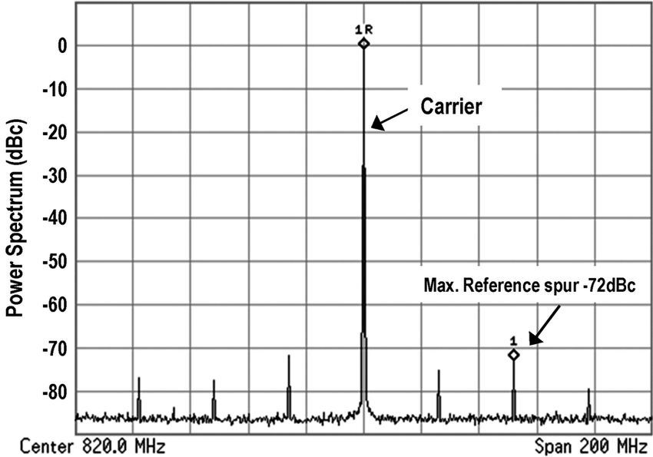
Spurious Emissions(spurs)
What are Spurious Emissions?
Spurious emissions are unintentional, unwanted radio frequency signals outside the necessary bandwidth.
“Unwanted radio noise pollution”
Why are they a problem?
Inefficient use of spectrum.
Interference with other devices.
Reduced battery life (wasted energy).
Compliance to regulations.

Slide 49
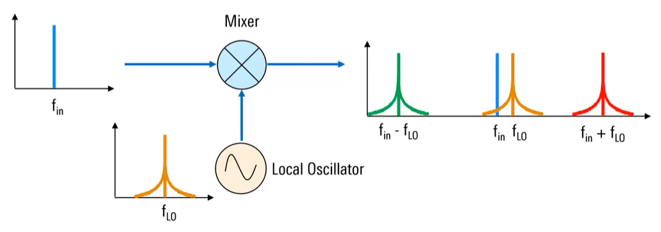
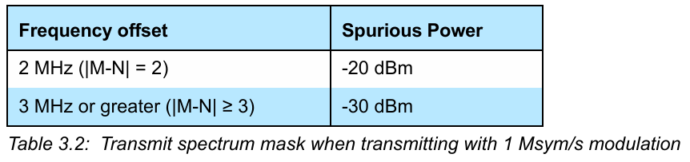
Spurious Emissions(spurs)
Where do spurs come from?
In-Band spurious emissions. (within the 2.400 - 2.4835 GHz band)
  Due to signal spread resulting from modulation.
(sharp transitions).
  PLL phase noise.

Slide 50
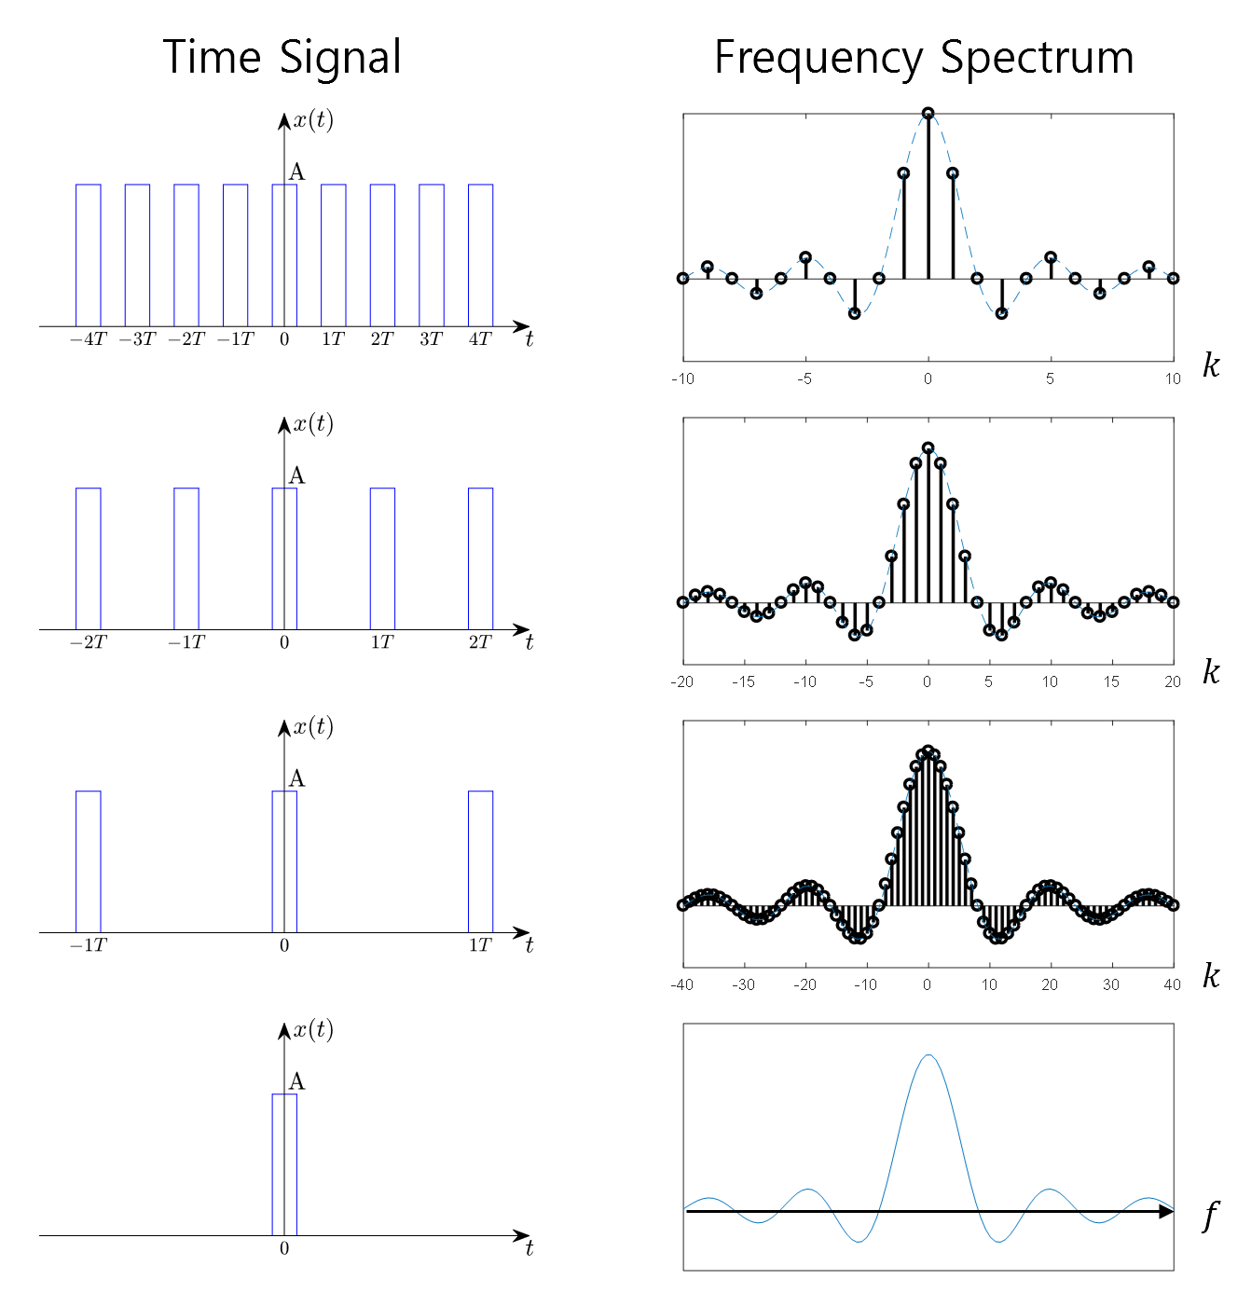
Spurious Emissions(spurs)
Where do spurs come from?
Out of band spurious emissions.
  Clocking (Harmonics).
  PA nonlinearities (Harmonics).
  Frequency Synthesizer leakage.
  Reference spurs.
  fractional-N PLL spurs.
The equipment manufacturer is responsible for the ISM out-of-band spurious emissions requirements in the intended countries of sale.

Slide 51
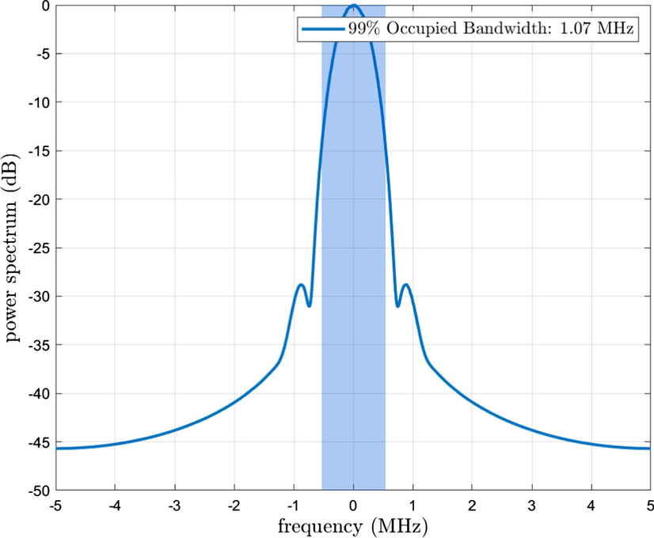
Spurious Emissions(spurs)
Introduced solutions
Pulse shaping:
  Use of Gaussian filter reduces side lobes and increases spectral efficiency “GMSK”.
Lower modulation index (optimum 0.5).
ADPLL reduces frequency leakage.
Dithering:
  Low-level, random noise is added to the signal
  to break up periodic patterns and spread them over
  a wider frequency range (reduces its amplitude).

Slide 52
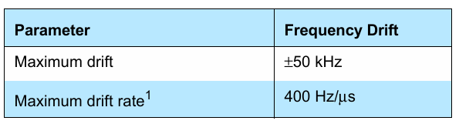
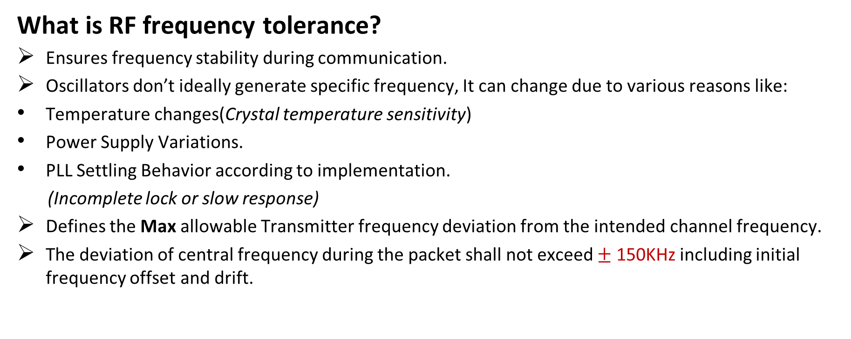
Radio Frequency Tolerance
What is RF frequency tolerance?
Ensures frequency stability during communication.
Oscillators don’t ideally generate specific frequency, It can change due to various reasons like:
Temperature changes(Crystal temperature sensitivity)
Power Supply Variations.
PLL Settling Behavior according to implementation.
(Incomplete lock or slow response)
Defines the Max allowable Transmitter frequency deviation from the intended channel frequency.
The deviation of central frequency during the packet shall not exceed $±$ 150KHz including initial frequency offset and drift.

Slide 53
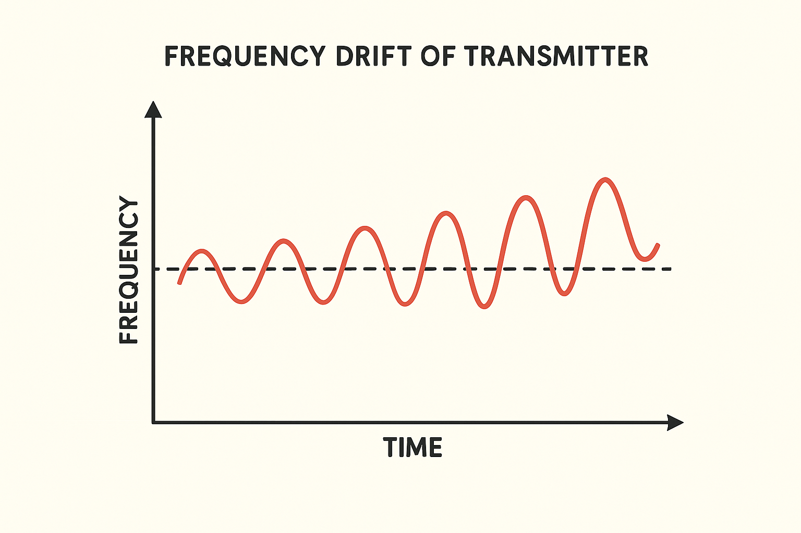
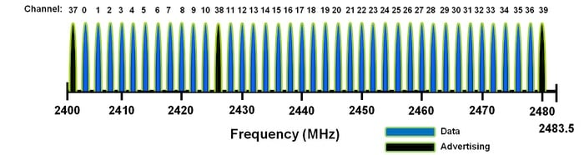
Radio Frequency Tolerance
Frequency Drift:
undesired change or variation in the oscillator output frequency during transmission.
What is the problem?
When frequency drifts from its center, it could interfere
with another adjacent channel.
The receiver will lose track of the packet.
Increased Bit Error Rate (BER).

Slide 54
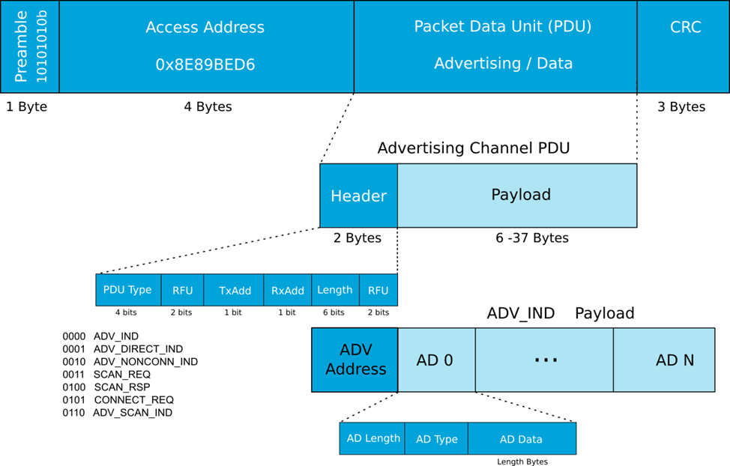
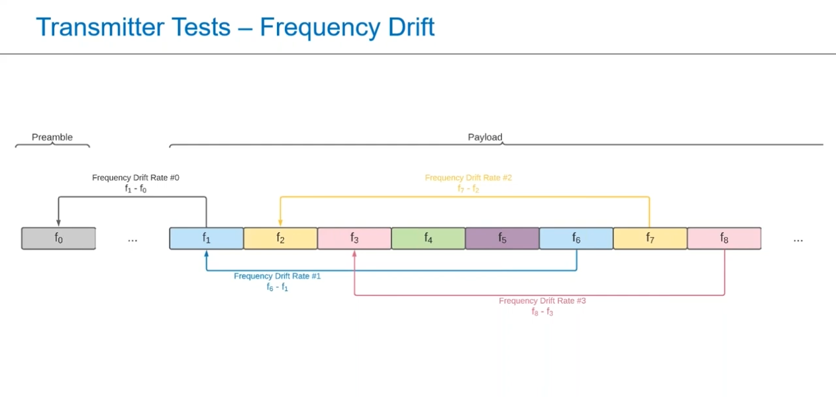
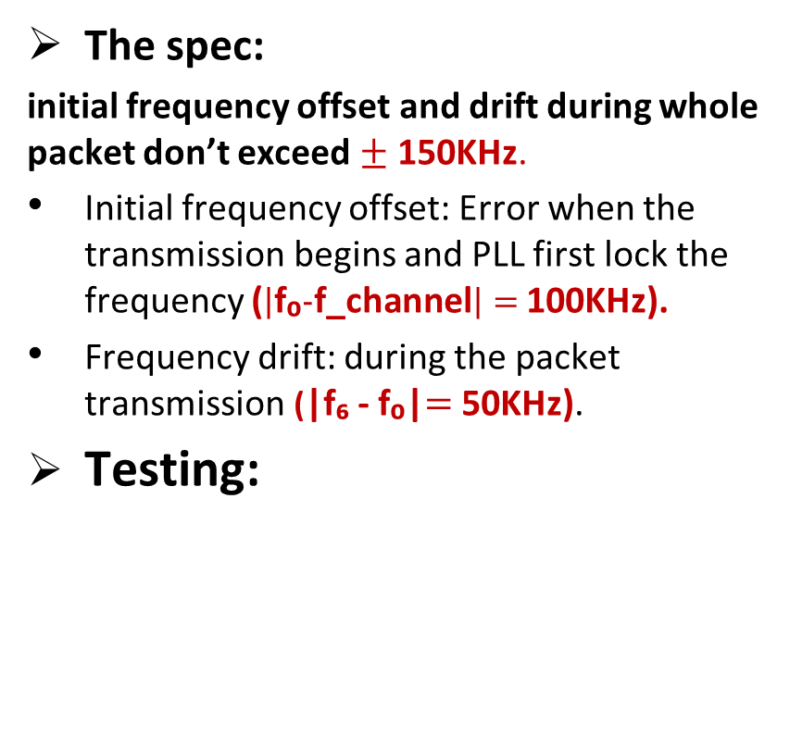
Radio Frequency Tolerance
The spec:
initial frequency offset and drift during whole packet don’t exceed $±$ 150KHz.
Initial frequency offset: Error when the transmission begins and PLL first lock the frequency ($\left|\text{f}\text{₀}−\text{f}\text{_}\text{channel}\right|=$100KHz).
Frequency drift: during the packet transmission (|f₆ - f₀|$=$50KHz).
Testing:

Slide 55
Radio Frequency Tolerance
Frequency drift rate:
The spec:
Drift rate shall be less than 400Hz/µs.
What is the problem?
Receiver uses preamble for synchronization.
When frequency drift rate is high receiver can lose synchronization.
“Channel estimation is inaccurate”.
Increased bit error rate.

Slide 56
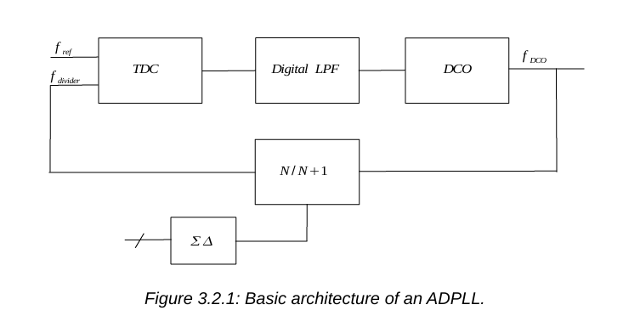
Radio Frequency Tolerance
Introduced solutions:
Short packets reduce drift effect.
Closed-loop frequency correction with receiver feedback.
ADPLL has better RF tolerance:
  Digital blocks are more resistant to PVT variations.
  Better frequency Positioning (DCO: fine frequency steps).
  Faster frequency settling.
  More immune to noise.

Slide 57
PLL

Slide 58
Table of content
PLL
  Introduction to PLL
  PLL Architecture
  PLL Type
  PLL limitation

Slide 59
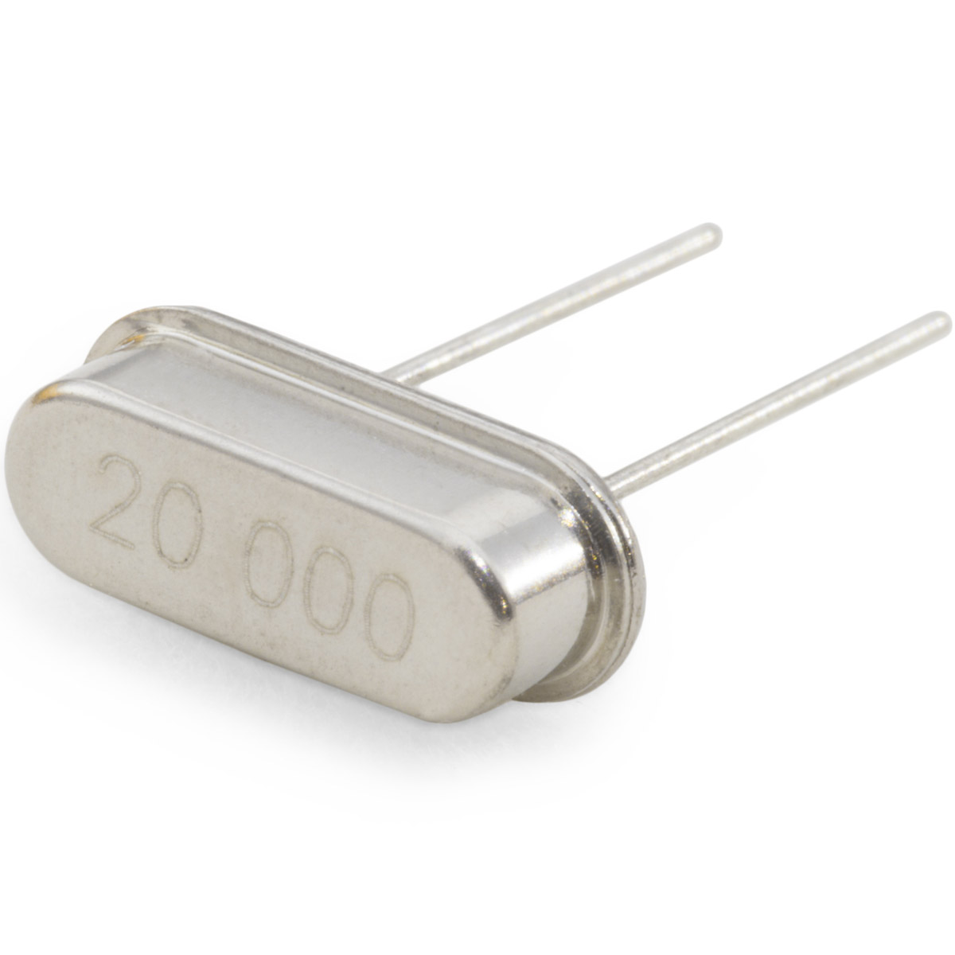
Introduction to PLL(Phase Locked Loop)
What is PLL?
A PLL is a circuit that locks the frequency and phase of one signal (its own output) to match another signal (a reference).
Why PLL?
We use a PLL rather than a normal crystal oscillator because it gives us a stable, accurate, and controllable frequency that always stays synchronized with a reference clock.
A normal oscillator can drift due to temperature, voltage, or noise, but a PLL continuously corrects itself by comparing its output to a precise reference, furthermore normal oscillators can only generate stable signals up to a few megahertz (MHz), but in modern systems Bluetooth, we need signals in the gigahertz (GHz) range.

Slide 60
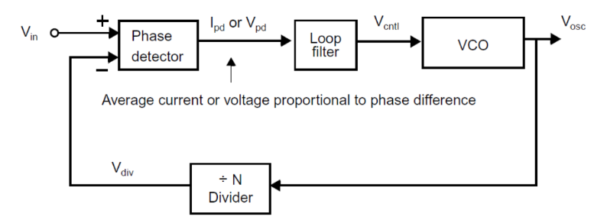
PLL Architecture
Why we use phase not frequency detector?
A frequency detector only checks if the two signals have the same frequency, but it cannot align their phases. The phase detector keeps comparing the two signals and adjusts the output until the phase difference becomes constant. When the phase difference is constant, it means the frequency error is zero, since frequency is the derivative of phase.
A Phase-Locked Loop (PLL) is a feedback control system that synchronizes the output frequency of a Voltage-Controlled Oscillator (VCO) with a reference signal in both frequency and phase. The main building blocks of a PLL are
  Phase detector: Compares the phase of the input reference signal and the VCO output.
  Low pass filter: Removes high-frequency noise from the PD output.
  VCO: Generates an oscillating signal whose frequency depends on the control voltage from the LPF.
  Frequency divider: Divides the VCO output frequency by a fixed or programmable number N then Sends this lower frequency back to the phase detector for comparison with the reference.

Slide 61
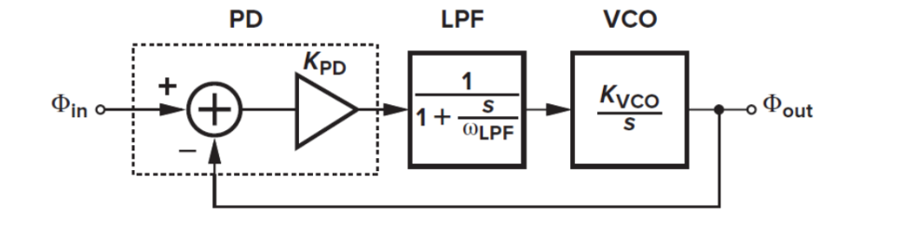
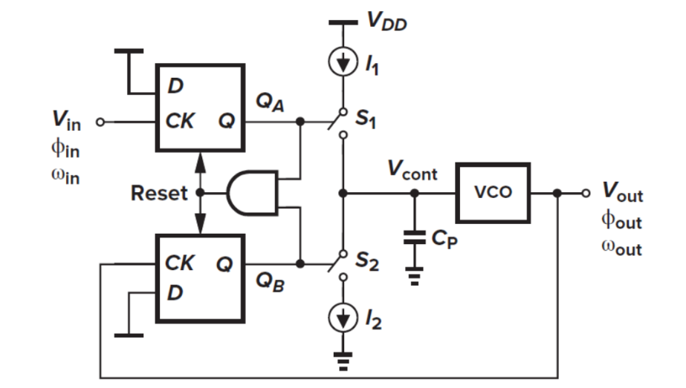

PLL Type
The type of PLL depends on how many integrators it has in the loop —
Type I has one, and Type II has two for more accurate locking.

Slide 62

PLL limitations
Passive loop filter components (resistors, MIMCAP) are difficult to scale
down as CMOS technology advances.
External loop filter introduces additional noise, requires more pads, and occupies larger PCB area.
Leakage current through the loop filter capacitor (MOSCAP) and charge pump becomes serious in sub-90 nm technologies.
The complexity of the circuit design is increasing, and for each technology it is needed to be redesigned
Analog components are sensitive to process, voltage, and temperature (PVT) variations.
Integration difficulty: passive elements and external components limit on-chip integration and compactness.
In summary Analog PLL are difficult to change form one technology to other technology
➡These limitations motivate the move toward more scalable and robust All-Digital PLLs (ADPLLs).

Slide 63
References
Bluetooth SIG. (2023). Bluetooth Core Specification 5.4. Retrieved from https://www.bluetooth.com/specifications/specs/core-specification-5-4/
[15] Bluetooth SIG, The Bluetooth® Low Energy Primer, Revision 1.3.0, Jan. 17, 2023. [Online]. Available: https://www.bluetooth.com/bluetooth-le-primer/
[2] F. Xiong, Digital Modulation Techniques, 2nd ed., Norwood, MA: Artech House, 2000.
[12] K. Murota and K. Hirade, “GMSK modulation for digital mobile radio telephony,” IEEE Transactions on Communications, vol. COM-29, pp. 1044–1050, July 1981.
[13] R. Ali and N. Zarka, GMSK Modulation, Presentation, Higher Institute for Applied Science and Technology, Feb. 2016

Slide 64
References
[1] B. P. Lathi and Z. Ding, Modern Digital and Analog Communication Systems, 4th ed. New York, NY, USA: Oxford University Press, 2009.
MXCOM Inc., Practical GMSK Data Transmission, Application Note, Winston-Salem, NC, USA, 1995. Reprinted from Wireless Design and Development, vol. 3, no. 1, Jan. 1995. [Online]
[2] H. A. Omran, "Analog/Mixed-Signal Simulation and Modeling: Introduction to Phase Locked Loops (PLL)," presented at the Faculty of Engineering, Ain Shams University, Cairo, Egypt, Aug. 16, 2024.
[16] N. Da Dalt and A. Sheikholeslami, Understanding Jitter and Phase Noise: A Circuits and Systems Perspective. Cambridge, U.K.: Cambridge University Press, 2020.

